Slide 1
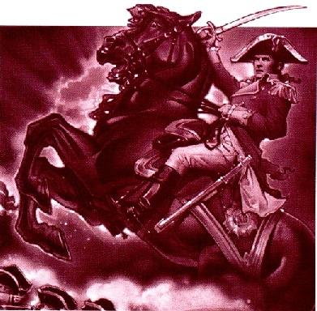

Matt Dayley, Jacob Meline, Joseph Richardson

Slide 2
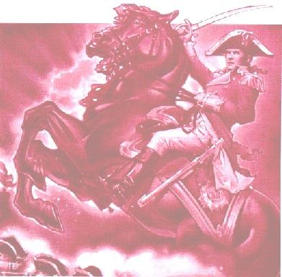
Overview
What is RISK?
Concept: Conquer the World
Why is it interesting?
Strategy and Probability both important
Dynamics change with number of players (2-6)
Many variations exist
Missions, Capitol, Neutrals, 3-dice defense, etc.
Politics; Game Theory
Notes:
Overview game rules/what it is
It’s been around a long time: is well-studied and played
Why so popular?
Initial placement has a large effect

Slide 3
So many strategies...
Spite
Break up continents
Make Allies
Look-Ahead
Aggresive
Random
Tit-For-Tat
Turtling
Strict probability
Few open borders
Smallest Continent First
Monte-Carlo
Opportunist
Prey on the weak
Notes:
There are 100’s
This game has had a long time to be studied and played

Slide 4
What we are doing:
Compare strategies
What works against one strategy may fail against another or against itself
Is there a clear winner?
How likely are the “best” algorithms to actually win?
Why Parallel?
Games are LONG (have you ever played this?)
Combinations are MANY (100’s of strategies, 2-6 players, alternate maps…)
Notes:
Order of players can make a difference, too

Slide 5
What we ARE NOT doing:
Developing a new strategy
Brute-force “look ahead”
Alliances and psychological factors
but still possible (Turtling…)
Alternate versions of the game
Can be re-used for that purpose with minimal change
Notes:
We did consider genetically re-combining strategy elements to develop a new strategy, but the timeline… and that’s not our chief goal.

Slide 6
Organization
GAME
FACTORIES
Strategies
--Claim
--Place
--Attack
--Defend
--Fortify
GameTask
-Map ID
-Strategy IDs
Map
--Regions
--Continents
Decision
State
Query
init
Game
Report
Internal State
Notes:
Talk about the Strategy interface
Talk about the factories?

Slide 7
Organization
Report.txt
GameManager
Slave
GameTask
1)Turns;Map;Turn Order; Ranking
2)Turns;Map;Turn Order; Ranking
3)Turns;Map;Turn Order; Ranking
4)Turns;Map;Turn Order; Ranking
5)Turns;Map;Turn Order; Ranking
6)Turns;Map;Turn Order; Ranking
7)Turns;Map;Turn Order; Ranking
...
Game
Report
Slave
GameTask
Game
Report
Analyzer
Slave
GameTask
Game
Final Output
Report
Final Output
Final Output
Notes:
How far along we are so far

Slide 8
Dominion Graph
“Best”
58%
72%
91%
Small Continents First
Prey on Weak
51%
56%
88%
76%
88%
56%
Break up enemy
99%
Aggresive
53%
89%
93%
56%
63%
“Bogo” Strategy
Notes:
Point out cycles, “winners”, etc.
Possible scoring schemes (number of wins, sum of % wins, etc)
This is the two-player version, but it can vary a lot

Slide 9
Results
Human-Controlled Strategy, for testing
Simple text-based UI
A set of Maps and Strategies
… but final analysis not yet finished
More strategies
Analysis program

Slide 10
Questions?

